Slide 1
Databases : Introduction
2018, Fall
Pusan National University
Ki-Joune Li

Slide 2
Goals of this course
Three Goals
Data Modeling
How to describe the information in the real world
Database Design
How to transform data models to database schema
How to formally describe databases in algebraic ways
Database Manipulation
How to handle databases
To retrieve
To insert/delete
To search

Slide 3
Evaluation
Four Tests : 65%
Test 1: 15%
Test 2: 15%
Test 3: 15%
Test 4: 20%
Design and Development: 30%
Three assignments are expected: 10% per each
Questions: 5%
How to get F
Absent one of the tests
Any missing assignment

Slide 4
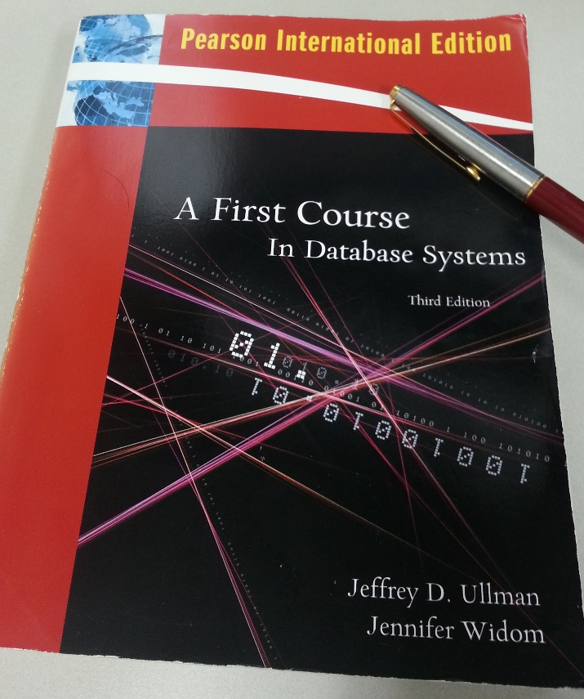
Other information
Web Page
stem.cs.pusan.ac.kr/Databases/2016/DB2016Fall.html
Teaching Assistants
Taehoon Kim, Donguk Seo, Hyung-Gyu Ryu, and Soo-Jin Kim: Building 313-Room 422
Textbook
A First Course in Database Systems, by J.D. Ullman and Jennifer Widom, 3rd edition, Pearson International Edition

