Slide 1
Databases ?
2018, Fall
Pusan National University
Ki-Joune Li

Slide 2
Questions
Q1 – Describe actual political situation in Korea.
Q2 – Make it machine-understandable.

Slide 3
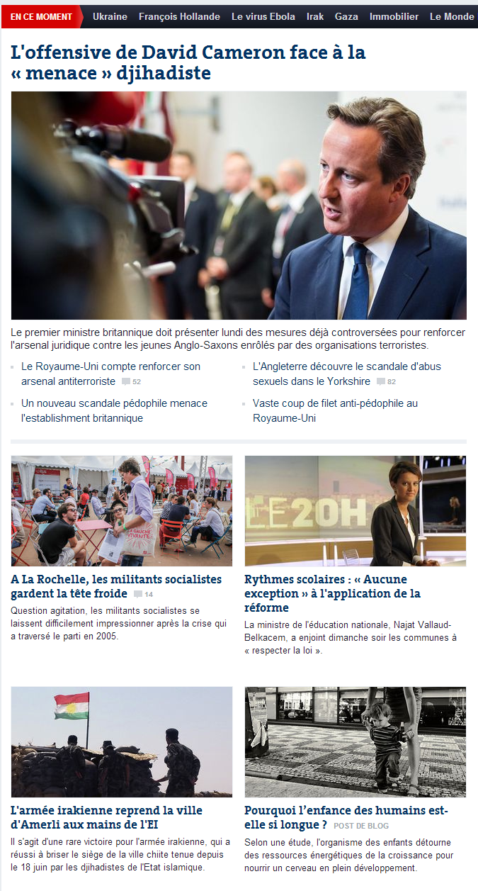
Overview on Databases
phase 3
Application
→ Management
Real World
Computer World
phase 1
phase 2
understanding
→ modeling
implementation
→ design and coding

Slide 4
Comparison with Software Lifecycle
part I
Requirement Analysis
Requirement Analysis
Functional Specification
Modeling
Design
part II
Schema Design
Development Environments
DB Environments
Coding
Data Collection and Input
Test
Quality Control
Maintenance
part III
Management and Retrieval
Software Life Cycle – Waterfall Model
DB Life Cycle

Slide 5
Plan
Part I – Data Modeling
Understanding it in formal ways
Object-Oriented Data Model (UML Class Diagram)
Relational Data Model (E-R Model)
Part II – Database Design
Relational Database Schema Design
Part III – Query Language
SQL
Part IV – Semi-Structured Data Model
XML

Slide 6
Two different aspects of DB
Applications are developed
on the conceptual understanding of real world
Applications
Logical (or Conceptual) Representation
How to conceptually
understand and describe
information
→ Database Issue
Independence
Physical Representation
How to physically organize data in file systems
→ DBMS Issue

Slide 7
Three Level Schema of Databases
Applications
External level (schema)
Logical (or Conceptual) Representation
Conceptual level (schema)
Independence
File Processing in Spring Semester
Physical Representation
Physical level (schema)

