Slide 1
Data Modelling
2018, Fall
Pusan National University
Ki-Joune Li

Slide 2
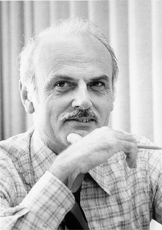
A brief history - What did Edgar F. Codd do in 1970?
In his historical paper, Codd, E. F. (1970). "A relational model of data for large shared data banks". Communications of the ACM 13 (6): 377.
He proposed a mathematical model to handle data in an algebraic way with a set of operators.
It is called Relational Data Model
Homework assignment #1: Write a short biography of Dr. Codd and summarize his paper in CACM, 1970

Slide 3
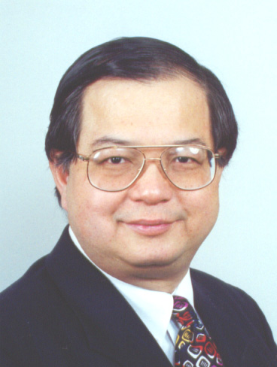
And Peter Chen did in 1976
Peter Chen, "The Entity-Relationship Model - Toward a Unified View of Data". ACM Transactions on Database Systems 1 (1), March, 1976
More expressive power
Everything by means of
Entity Set and
Relationship

Slide 4
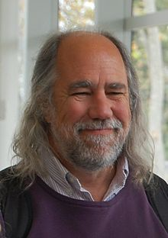
Then Object-Modeling Technique (OMT)
James Rumbaugh, et al., 1990, Object-Oriented Modeling and Design. Prentice Hall. ISBN 0-13-629841-9
More Advanced than Object-Oriented Modeling
Then it has been unified into UML in 1999.
UML (Unified Modeling Language)
J. Rumbaugh
G. Booch

Slide 5
What is a Class Diagram?
A class diagram describes
the types of objects in the system and
the various kinds of static relationships that exist among them.
A graphical representation of a static view on declarative static elements.
A central modeling technique that runs through nearly all object-oriented methods.
The richest notation in UML

Slide 6
Essential Elements of a UML Class Diagram
Class
Attributes
Operations
Relationships
Associations
Generalization
Dependency
Realization
Constraint Rules and Notes

Slide 7
Classes
A class: Description of a set of objects having similar
attributes,
operations,
relationships and behavior
An entity type to be stored in DB
Class Name
Window
size: Size visibility: boolean
Attributes
display() hide()
Operations

Slide 8
Associations
A semantic relationship between classes
To specify connections among their instances.
A structural relationship
To specify that objects of one class are connected to objects of a second (possibly the same) class.
Example
An Employee works for a Company

Slide 9
Example
Role name
Association name
instructor
Faculty
Student
1..*
instructs
*
Role
Navigable (uni-directional) association
Multiplicity
*
Courses
pre -requisites
0..3
Reflexive association

Slide 10
Associations: Name and Role
Association has a name
To clarify its meaning
The name is represented as a label placed midway along the association line.
Usually a verb or a verb phrase.
A role is an end of an association where it connects to a class.
May be named to indicate the role played by the class attached to the end of the association path.
Usually a noun or noun phrase
Mandatory for reflexive associations

Slide 11
Associations: Multiplicity or Cardinality
Multiplicity
The number of instances of the class associated with an instance of the class with the association
Indicates whether or not an association is mandatory.
Provides a lower and upper bound on the number of instances

Slide 12
Associations: Notations for Multiplicity
Multiplicity Indicators
Exactly one | 1
Zero or more (unlimited) | * (0..*)
One or more | 1..*
Zero or one (optional association) | 0..1
Specified range | 2..4
Multiple, disjoint ranges | 2, 4..6, 8

Slide 13
Association Class
employer
works for
employee
Company
Person
0..*
1..*
Contract
- Salary
- Position

Slide 14
Aggregation
A special form of association that models a whole-part relationship between an aggregate (the whole) and its parts.
Models a “is a part-part of” relationship.
Whole
Department
1..1
3..*
40..*
1..10
Chair
Faculty
Student
Staff
Part

Slide 15
Composition
A strong form of aggregation
The whole is the sole owner of its part.
The part object may belong to only one whole
Multiplicity on the whole side must be zero or one.
The life time of the part is dependent upon the whole.
The composite must manage the creation and destruction of its parts.
Point
Polygon
3..*

Slide 16
Generalization
Any object of the specialized class (subclass) is a concrete objects of the generalized class (super-class).
“is kind of” relationship.
{abstract} is a tagged value that indicates that the class is abstract. The name of an abstract class should be italicized
An abstract class
Shape {abstract}
Super Class
Generalization relationship
Sub Class
Circle

Slide 17
Generalization: Inheritance
A sub-class inherits from its super-class
Attributes
Operations
Relationships
A sub-class may
Add attributes and operations
Add relationships
Refine (override) inherited operations
belong to
Employee
Division
Professor
College

Slide 18
A sample model
We are planning to design a database for university security management with RFID keys.
The entrances of university buildings have RFID lock system.
Each member of university has a RFID key with her/his ID.
There are three types of university members: students, employees, and faculty members
Employees have the full access of their department buildings.
Students has an access to pre-assigned building and rooms only for allowed time period. It is controlled by each department chair.
The access of each faculty office room is allowed only to the faculty, where each faculty member has a faculty office room.
We need a list of entrances of each building every day and the list contain (name, type, his/her department, entrance time, building name, door number)

Slide 19
Constraints
Not all semantics can be described by UML class diagram
To make it more expressive, we need Constraints
Key Constraints
Referential Integrity

Slide 20
Constraints – Key Constraints
Key
A set of attributes that are not allowed to have same values in different instances of a class
Key and Primary Key
Every class has at least one key
Class may have more than one key
citizen ID, (name, address) are both keys
Primary Key
One of Primary Key
Basically, any instance of a class is identified by its PK.
Employee
- name
- address
- citizen ID
- division
- phone
PK: (name, address)

Slide 21
Constraints – Referential Integrity
In relationship (Association, Aggregation, Composition) between two classes A and B, the referenced instance in B from an instance in class A must exist.
A
B
belong to
Employee
Division
1..*
1..1
Ki-Joune Li
belong to: Dept. CS
?? Dept. CS
In C-Lang. →
Include Pointer to B in A
How to reference an instance in class B from an instance in class A?
In DB →
Include PK of B in A
Foreign Key
PK (of B) included in A

Slide 22
Weak Entity Sets
belong to
Example
Player
Football team
1..*
1..1
- name
- back number
- position
- team name
- city
- sponsor
is a key?
belong to
1..1
Coach
0..*
- name
- level
- specialty
Observation 1
Observation 2: if football team is also a weak entity set?
No, but (back number, team name) is a key
→ Player is a Weak Entity Set.
→ "belong to" is a supporting relationship of "Player"
→ "Football team" is a supporting class of "Player"
Why does it happen ?
Observation 3: referential integrity

Slide 23
E-R Model
ER (Entity-Relationship)
Prior to OMT, an extension of Relation model
Very Similar with UML Class Diagram
UML Class Diagram | ER Model
Class | Entity Set
Association | Relationship
Aggregation/Composition/ Generalization | is-a relationship
Attribute | Attribute
isa

Slide 24
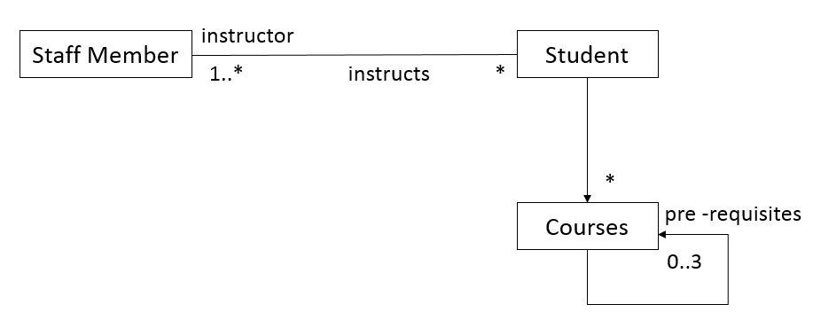
ER Model
name
dept.
instructor
instructs
Faculty
Student
Receives
phone
Courses
pre-
requisites

Slide 25
ER Model – isa Relationship
title
length
year
Movie
Generalization
isa
isa
Cartoon
Murder
Voice
Weapon
Star

Slide 26
ER Model – isa_kind_of and isa_component_of
Reg. no.
Owner
Manf. year
Car
Composition: isa_component_of
isa
isa
Engine
Gear

Slide 27
Differences from UML Class Diagram
Cardinality: by arrow type
Many: simple line
One: arrow
example: many employees to one division
Working
for
Employee
Division

Slide 28
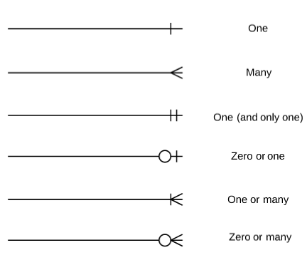
Cardinality Notations of ER-Model

Slide 29
Differences from UML Class Diagram
Multi-way relationship
In UML Diagram?
Year-
date
No.
Attendants
Marriage
Husband
Wife
Wedding
Hall

