Slide 1
Relational Model
2018, Fall
Pusan National University
Ki-Joune Li

Slide 2
Basic Ideas of Relational Model
A mathematical notation
rather than diagrammatic notations such as UML diagram
Structures
A Database : Set of Tables
A Table: Relation R between A₁, A₂, ..., A_{n}
R ⊆ A₁x A₂ x ...x A_{n} = { (a₁,a₂,a₃,...,a_{n})| a_{i} ∈ A_{i} }
A_{i} : attribute (or domain, field)
a_{i} : attribute value
schema: R (A₁, A₂, ..., A_{n})
tuple: (a₁,a₂,a₃,...,a_{n})

Slide 3
Relation as a Table
Attributes
(column headers)
Beers
Name | Manufacturer
Hite | Jinro
Cass | OB
Tuples
(rows)
Beers (Name, Manufacturer)

Slide 4
Relational Schema
Relation schema =
relation name
attributes, in order (+ types of attributes).
Example: Beers(name, manufacturer) or Beers(name: string, manf: string)
key definition
Any additional constraints
Example
Schema: Movie(title, year, length, genre)
Movie
+ title
+ year
+ length
+ genre
In UML

Slide 5
Why Relational Model
Very simple model.
Often matches how we think about data.
Relational Model and SQL
Most important database language today
Not Procedural but Declarative
Once optimized by DBMS, then Ideal
Algebraic Background
Relational Algebra

Slide 6
Schema Definition in SQL
SQL (pronounced as “sequel” or SQL)
A declarative Language for relational databases
DDL (Data Definition Language) – Schema Definition
Table
View - External Layer of DB
DML (Data Manipulation Language) – Querying
Schema Definition in SQL
Example
CREATE TABLE Movies (
title CHAR(100),
year INT,
length INT,
genre CHAR(10),
studioName CHAR(20),
producerC# INT,
PRIMARY KEY (title, year)
);

Slide 7
Basic Data Types in SQL
CHAR(n), or VARCHAR(n)
BIT(n), or BIT VARYING(n)
BOOLEAN
INT, or INTEGER, SHORTINT
FLOAT or REAL, DOUBLE PRECISION, DECIMAL(n,d)
DATE, TIME

Slide 8
More about SQL for Relation Schema
Modification
DROP TABLE Movies;
ALTER TABLE Movies ADD address CHAR(100); or
ALTER TABLE Movies DROP producerC#;
Default Values and Keys
CREATE TABLE Movies (
movie# INT PRIMARY KEY,
title CHAR(100),
year INT,
length INT,
genre CHAR(10) DEFAULT ‘UNKNOWN’,
studioName CHAR(20),
producerC# INT,
);

Slide 9
Relational Algebra
Algebra: Set (Operands) + Operators
In Relational Algebra
Operand: Relation (Table)
Operator: Relational Operators
Set Operator: Union, Intersection, Difference
Selection
Projection
Join
Aggregate

Slide 10
Relational Operators: Set Operators
Union (∪)
Intersection (∩)
Difference (-)

Slide 11
Relational Operators : Select
Selection (σ_{condition})
Retrieve records satisfying predicates
Example
Find Student where Student.Score > 3.5
σ_{score>3.5}(Student)
Index or Hash
Predicate
Select

Slide 12
Relational Operators : Project
Project (∏_{attributes})
Extract interesting attributes
Example
Find Student.name where score > 3.5
∏_{name}(σ_{acore>3.5}(Student))
Full Scan
Interesting attributes to get
Extract

Slide 13
Cartesian Product
Cartesian Product (×)
Two Tables : R₁ × R₂
Produce all cross products
Join ( )
r₁₁
r₂₁
r₁₁
r₂₂
…
…
R₁
R₂
r₁₁
r_{2n}
r₁₂
r₂₁
r₁₁
r₂₁
×
=
r₁₂
r₂₂
r₁₂
r₂₂
…
…
…
…
r₁₂
r_{2n}
r_{1m}
r_{2n}
…
…
r_{1m}
r₂₁
r_{1m}
r₂₂
…
…
r_{1m}
r_{2n}

Slide 14
Join
Join ( )
Select combined records of Cartesian product with same value of a common attribute (Natural Join)
Example
Student (StudentName, AdvisorProfessorID, Department, Score)
Professor(ProfessorName, ProfessorID, Department)
Student _{AdivsorProfessorID=ProfessorID} Professor
= σ _{AdivsorProfessorID=ProfessorID}(Student ×Professor)
Natural Join vs. Theta Join
Natural Join
Theta Join - as for SELECT, condition can be any Boolean condition.
Historic versions of this operator allowed only A theta B, where theta was =, <, etc.; hence the name “theta-join.”

Slide 15
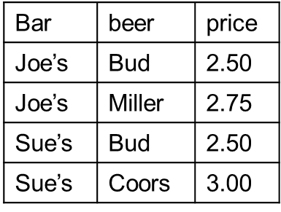
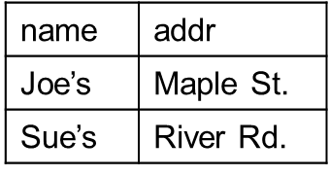
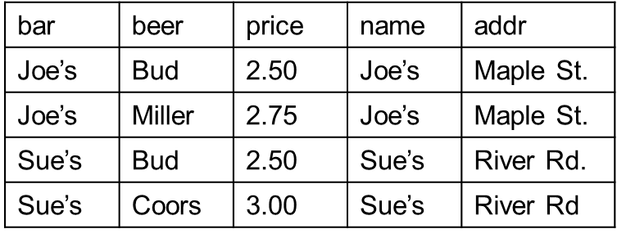
Join – Natural Join Example
Sells (bar, beer, price)
Bars (name,addr)
BarInfo = Sells _{Sells.bar = Bars.name} Bars = Sells Bars
BarInfo (bar, beer, price, name, addr) → BarInfo(bar, beer, price, addr)
bar | beer | price | addr
Joe’s | Bud | 2.50 | Maple St.
Joe’s | Miller | 2.75 | Maple St.
Sue’s | Bud | 2.50 | River Rd.
Sue’s | Coors | 3.00 | River Rd

Slide 16
Relational Algebra
Relational Algebra
Operand : Table (Relation)
Operator : Relational Operator (σ, ∏, , etc)
Example: SQL and relational algebra
find Student.Name from Student, Professor where Student.Score > 3.5 and Student.AdvisorProfessorID=Professor.ID and Professor.Department=‘CSE’
∏_{student.name}(σ_{score>3.5}(Student) σ_{Department=‘CSE’} (Professor) )
Relational Algebra Specifies the sequence of operations
σ
σ
∏

Slide 17
Expression Tree, and execution order
Professor
R ∩ S = R – (R – S)
R _{C} S = σ_{C} (R X S)
Student
σ_{score>3.5}
1
2
σ_{Department=‘CSE’}
Equivalent
3
Student
Professor
∏_{student.name}
4
X
1
Expression Tree
2
σStudent.score>3.5 and Professor.Department =‘CSE’
3
∏_{student.name}

Slide 18
Constraints on relations
Referential constraints
One-way association in UML
Student(name, ID, dept, score), Department(name, college, office)
then
∏_{dept}(Student) ⊆ ∏_{name}(Department) or
∏_{dept}(Student) - ∏_{name}(Department) = ∅
i.e. every value of Student.dept must be found in Department.name
i.e. the reference of Department from Student must exist.
Student
Department

Slide 19
Key Constraint
At least one attribute or one combination of attributes to identify each tuple.
Example
Student (name, ID, dept, score)
If ID is key attribute of Student, then
σStud1.ID=Stud2.ID AND Stud1.dept≠Stud2.dept (Stud1 X Stud2) = ∅
where ρ_{Stud1}(Student) and ρ_{Stud2}(Student)
renaming

Slide 20
From UML to Relational Model
Class to Relational Schema
Association
Aggregation/Composition
Inheritance
Weak Entity Set

Slide 21
From Class to Relation
Employee
CREATE TABLE Employee (
name CHAR(30),
address CHAR(100),
citizenID CHAR(12) PRIMARY KEY,
division CHAR(20),
salary REAL
);
+ name
+ address
+ citizen ID
+ division
+ salary

Slide 22
From Association to Relation Schema
One-way association
Why not in Company ?
Person
Company
worksFor
+ name
+ age
+ ID: Key
+ name
+ address
+ category
PK(name, address)
CREATE TABLE Person (
name CHAR(30),
age INT,
ID CHAR(12) PRIMARY KEY,
companyName CHAR(40), companyAddress CHAR(100)
);

Slide 23
From Association to Relation Schema
Two-way association
Why not with Player and Team?
20..*
1..*
Team
Player
+ name
+ age
+ position
+ ID
PK(ID)
+ name
+ address
+ city
+ sponsor
PK (name)
Contract
- signYear
- salary
CREATE TABLE Contract(
signYear Year,
salary INT,
playerID CHAR(12),
teamName CHAR(40),
Primary Key (playerID, teamName) );

Slide 24
From Aggregation to Relation Schema
Either as one-way association or Two-way association

Slide 25
From inheritance to relational schema
Person
CREATE TABLE Person (
name CHAR(30),
age INT,
ID CHAR(12) PRIMARY KEY,
);
+ name
+ age
+ ID: Key
Student
Employee
CREATE TABLE Student(
name CHAR(30),
age INT,
ID CHAR(12) PRIMARY KEY,
dept CHAR(30),
studentID INT Key,
score REAL
);
+ dept
+ studentID
+ score
+ division
+ salary
+ position

Slide 26
Handling Weak Entity Set
belong to
Player
Football team
1..*
1..1
- name
- back number
- position
- team name
- city
- sponsor
Weak Entity Set
CREATE TABLE Player (
name CHAR(30),
backNumber INT,
position CHAR(3), teamName CHAR(30),
Primary Key (backNumber, teamName) );

Slide 27
Handling Weak Entity Set
belong to
Player
Football team
1..*
1..1
- name
- back number
- position
- team name
- city
- sponsor
CREATE TABLE belongTo (
backNumber INT,
teamName CHAR(30),
teamName CHAR(30),
Primary Key (backNumber, teamName) );

