Slide 1
PostgreSQL tutorial
2016, Fall
Pusan National University
Taehoon Kim

Slide 2
What is PostgreSQL?
https://www.postgresql.org
The world’s most advanced open source database
Object-relational database (ORDBMS)
Cross-platform
Latest Version : 11.1
Release date : 2018-11-08

Slide 3
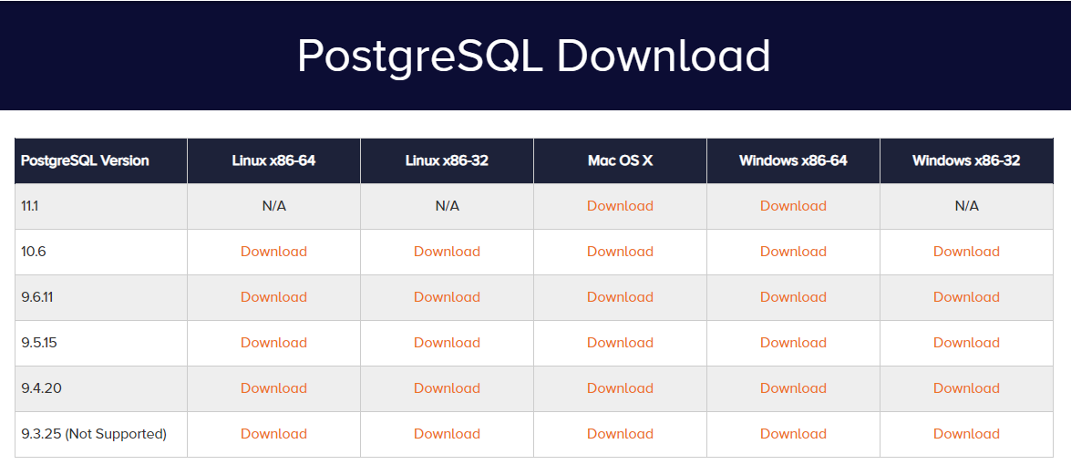
Download PostgreSQL
Go to this URL
http://www.enterprisedb.com/products-services-training/pgdownload#windows
Select stable version(currently v 9.6.11) and choose OS

Slide 4
Installation Error solution(Windows)
Please change your user name from Korean to English
If Installer is not opened, please enter this command
Go to the directory where Installer is
(Installer exe file name) --install_runtimes 0

Slide 5
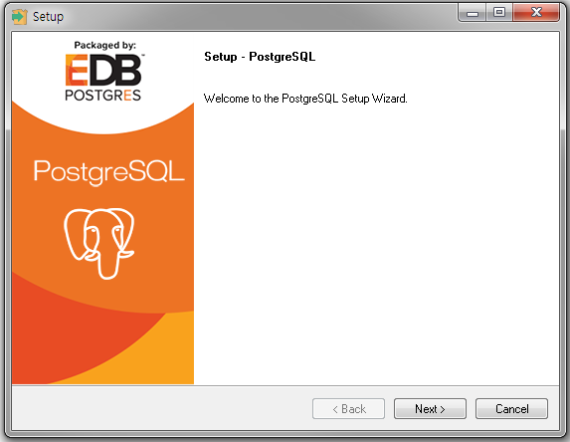
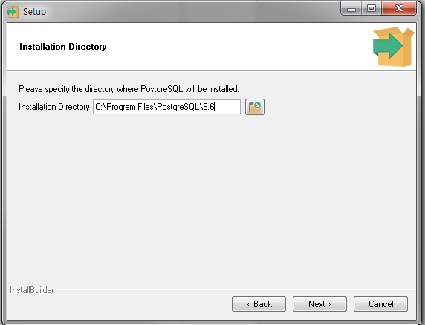
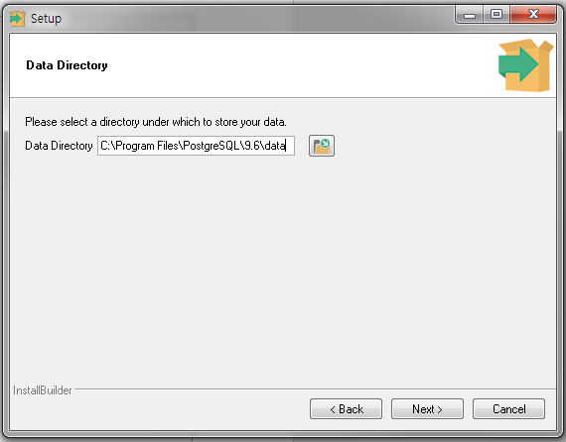
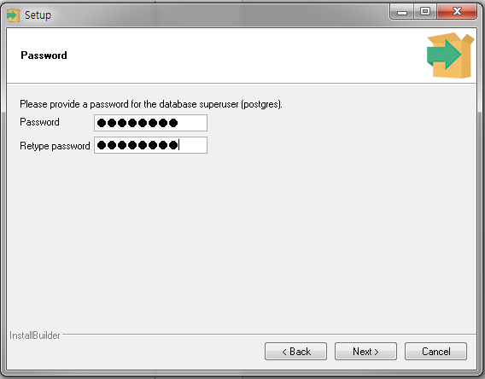
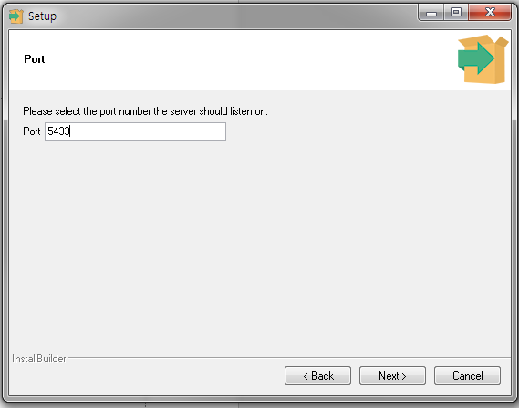
Install PostgreSQL
Lunch downloaded file(postgresql-9.6.11-xxx.exe)
Press ‘Next’ button until ‘Password’ is updated.

Slide 6
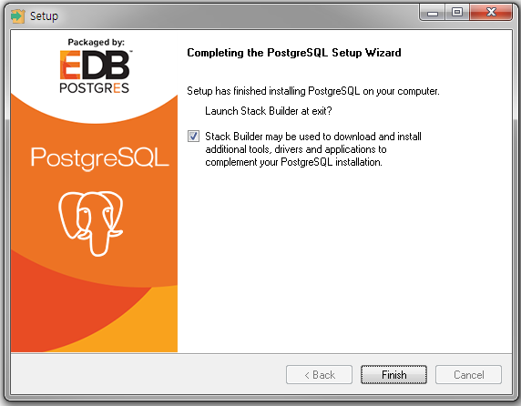
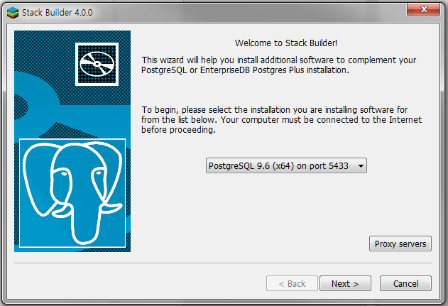
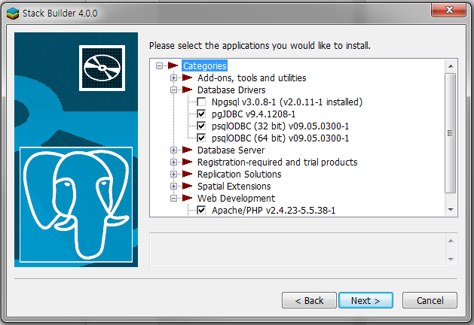
Stack Builder?
When the installation ends, you can choose this option
You can use the JDBC installation on Stack Builder
Other options? If you want, do it

Slide 7
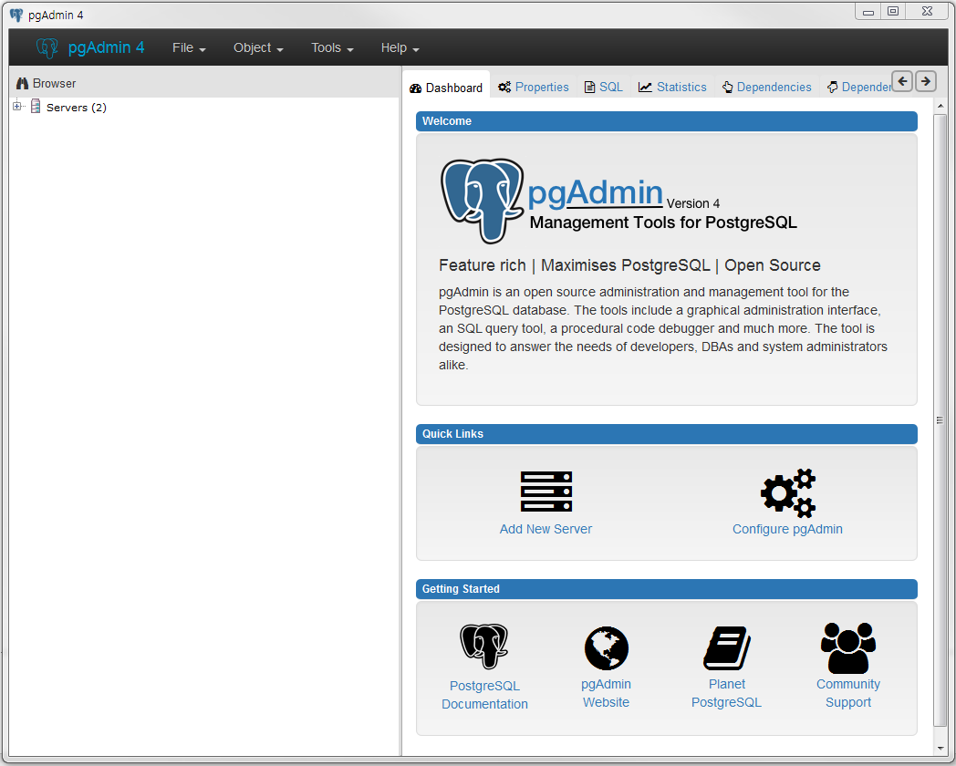
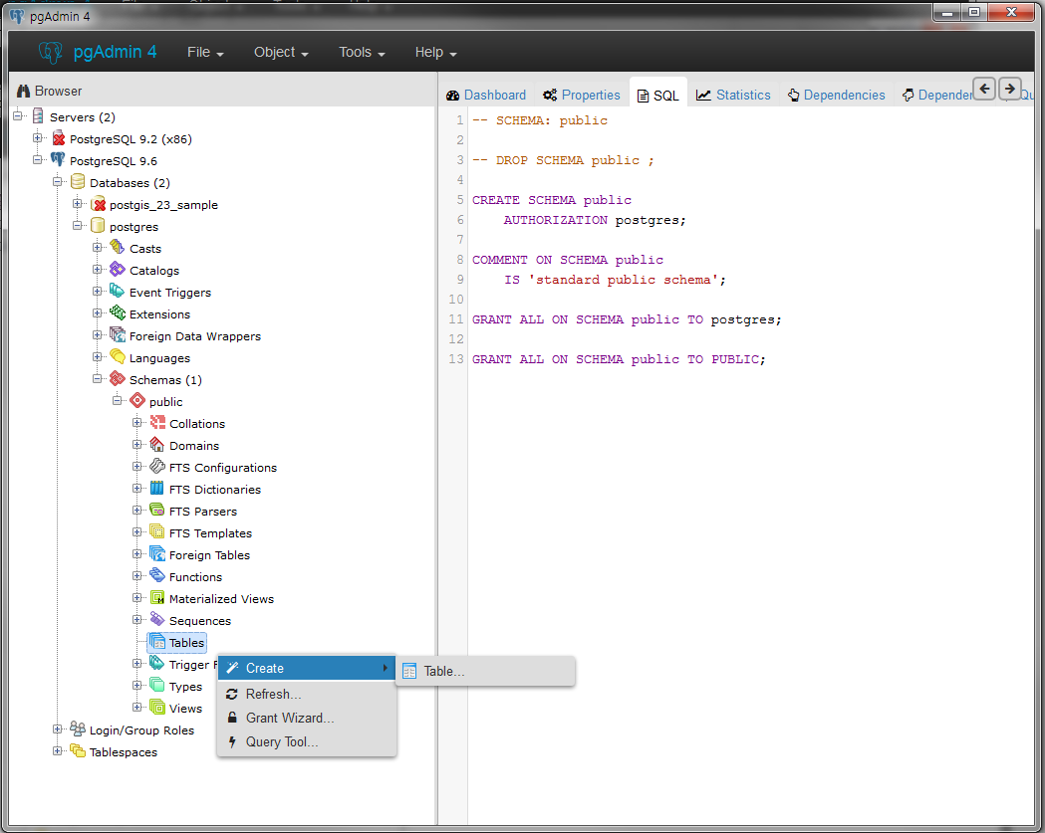
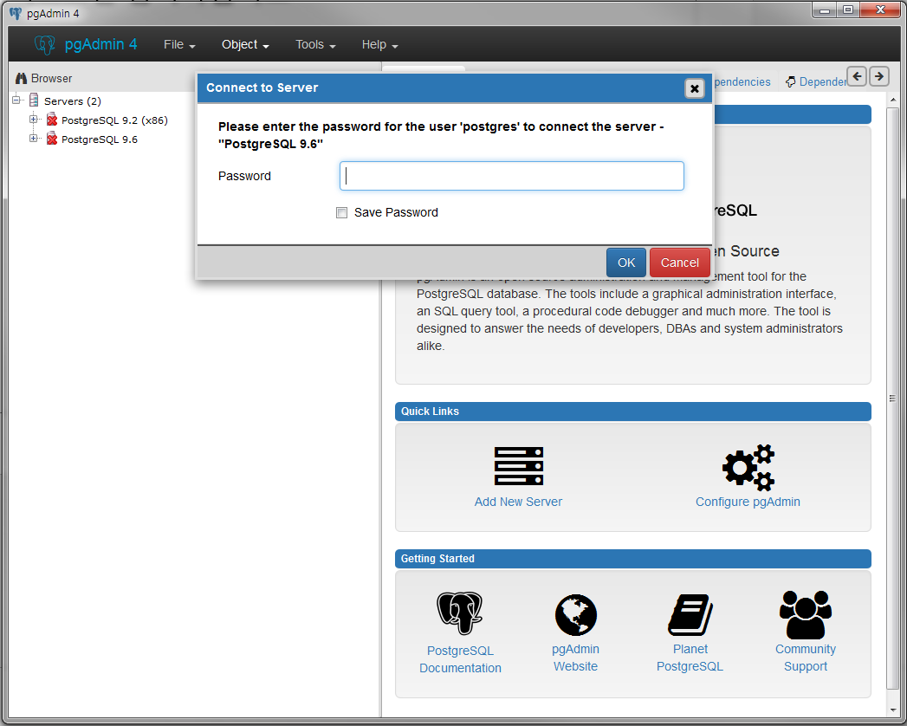
Launch pgAdmin 4
Databases → postgres
Schemas → public
tables → Create → Table
Select PostgrSQL 9.6
And enter your passwords
This is main screen

Slide 8
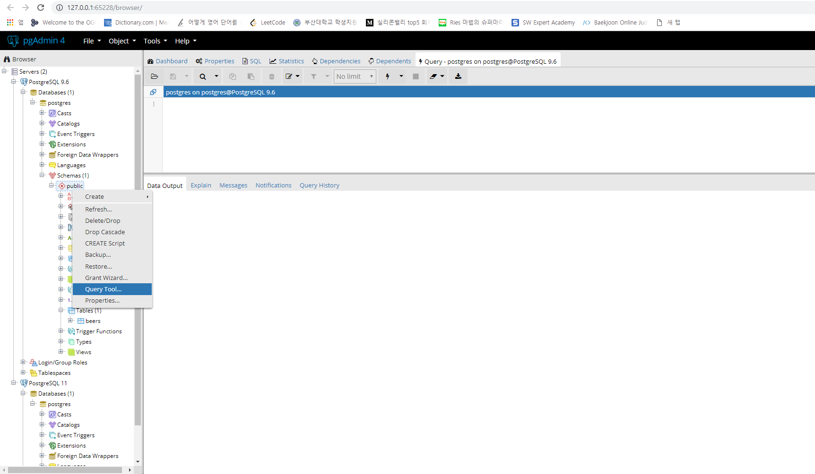
Create Table (1) – by SQL statement (1)
CREATE TABLE Beers (
name CHAR(20),
manf CHAR(20),
PRIMARY KEY (name))

Slide 9
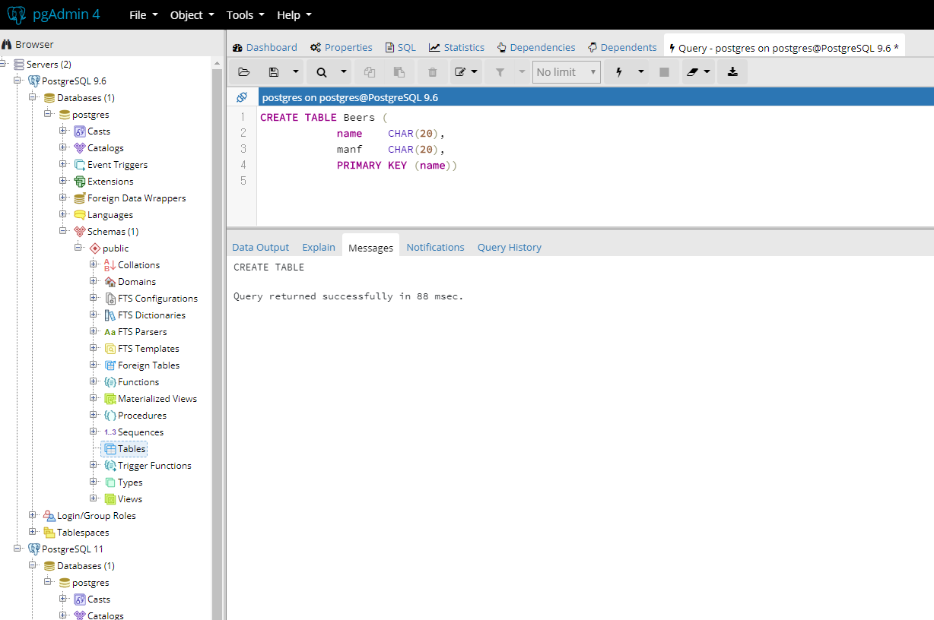
Create Table (1) – by SQL statement (2)
CREATE TABLE Beers (
name CHAR(20),
manf CHAR(20),
PRIMARY KEY (name))

Slide 10
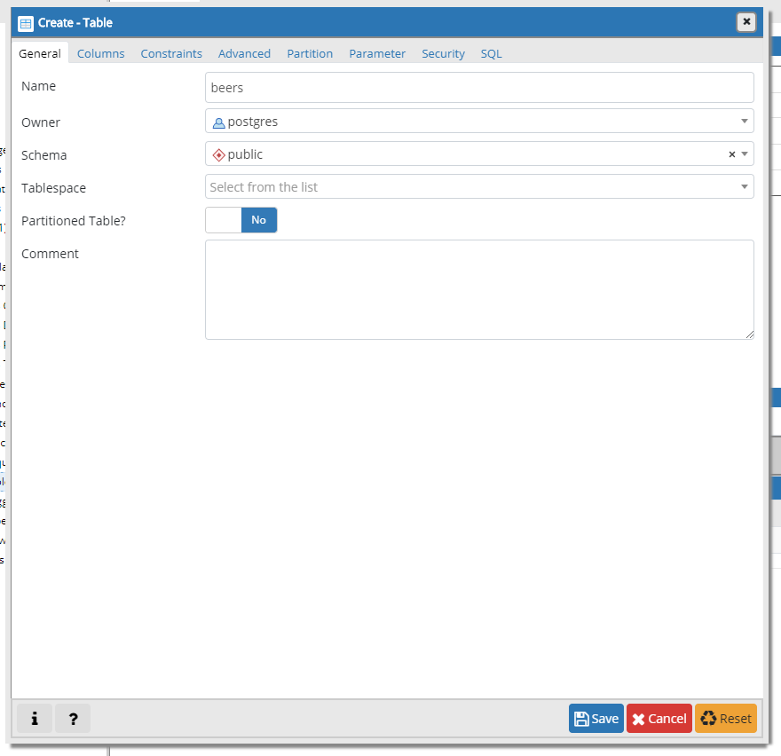
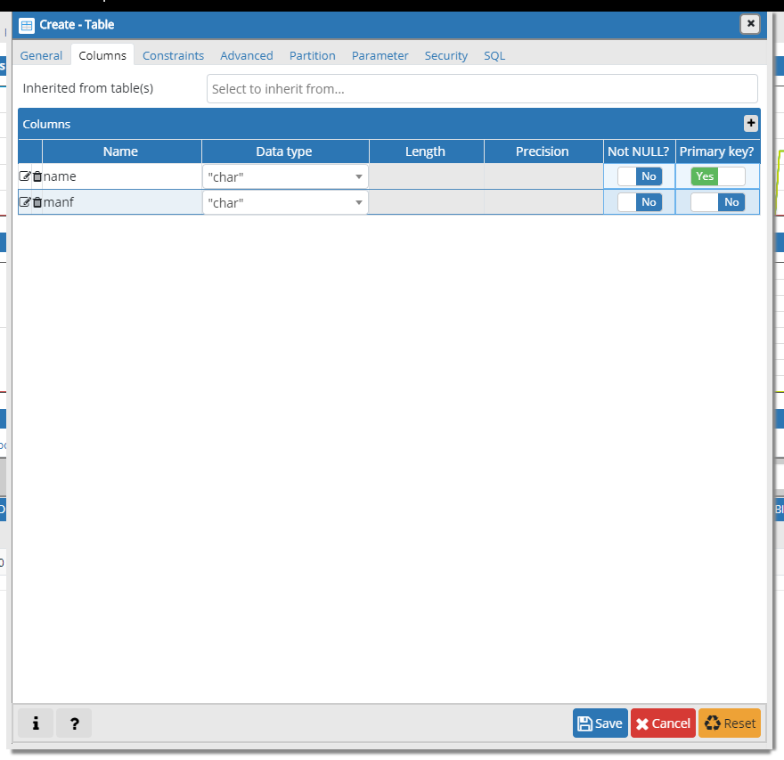
Create Table (2) - by setting window

Slide 11
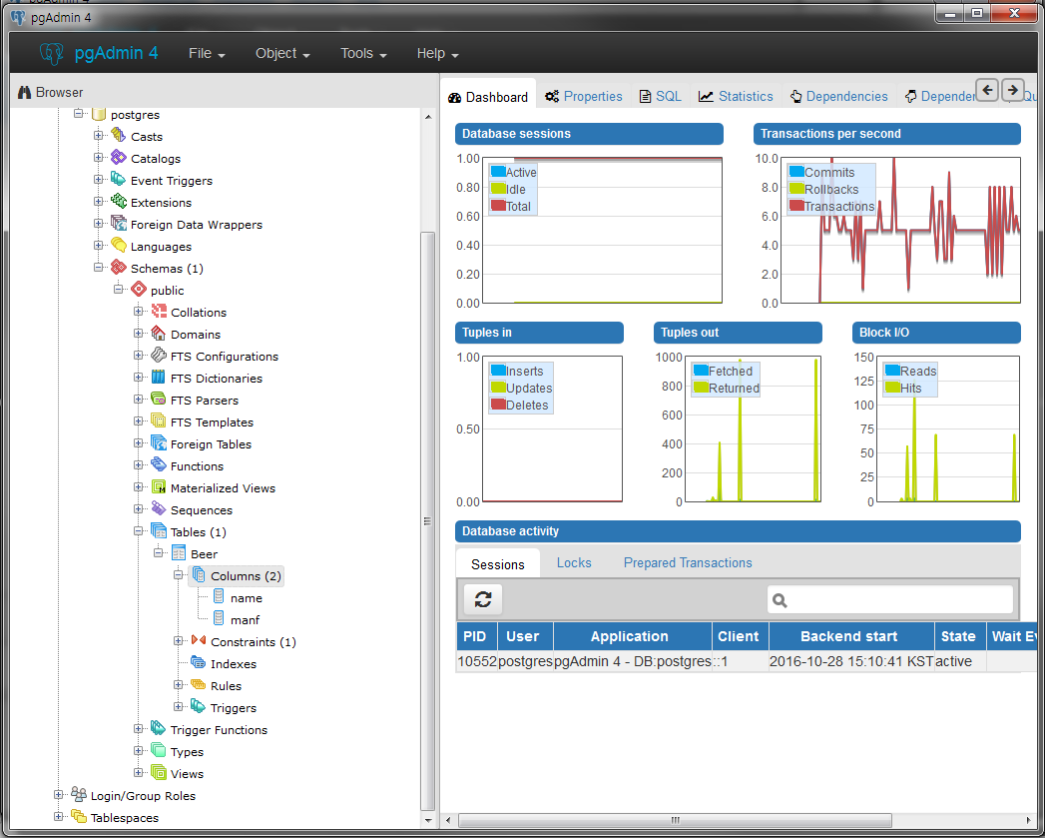
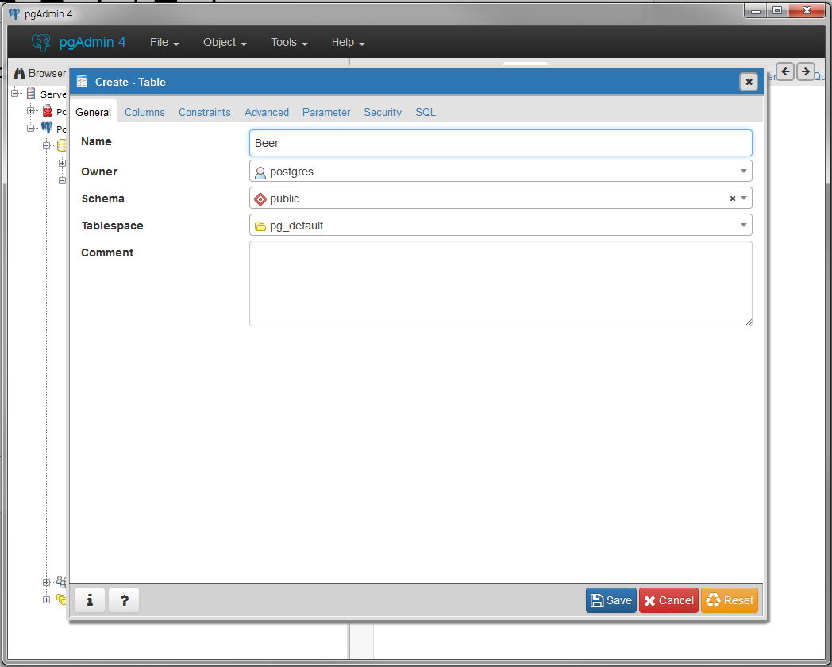
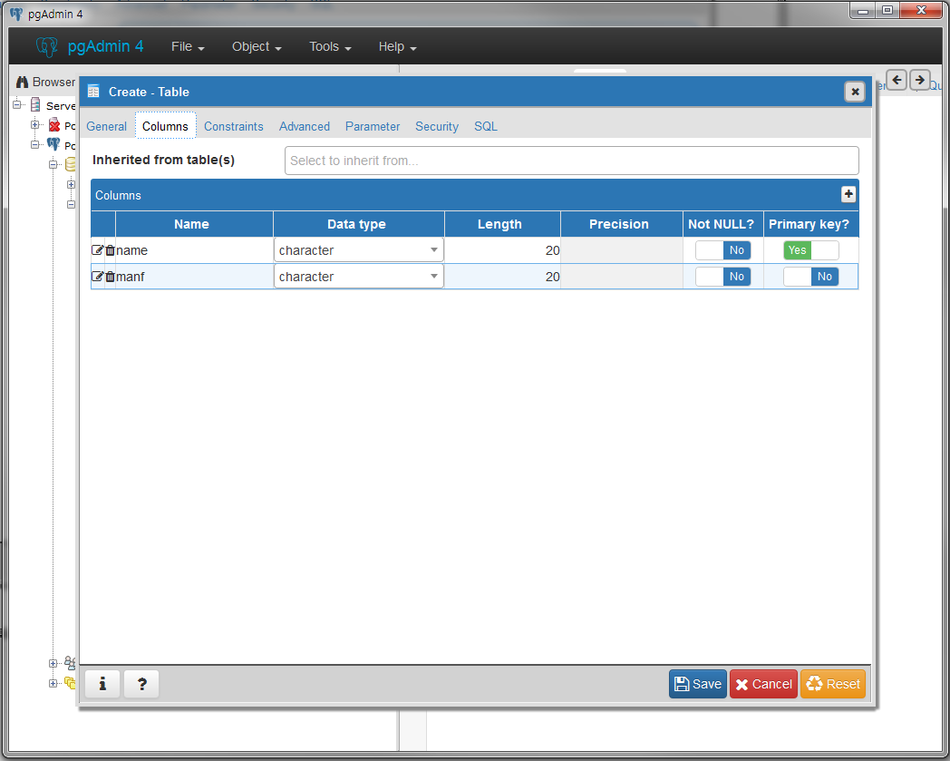
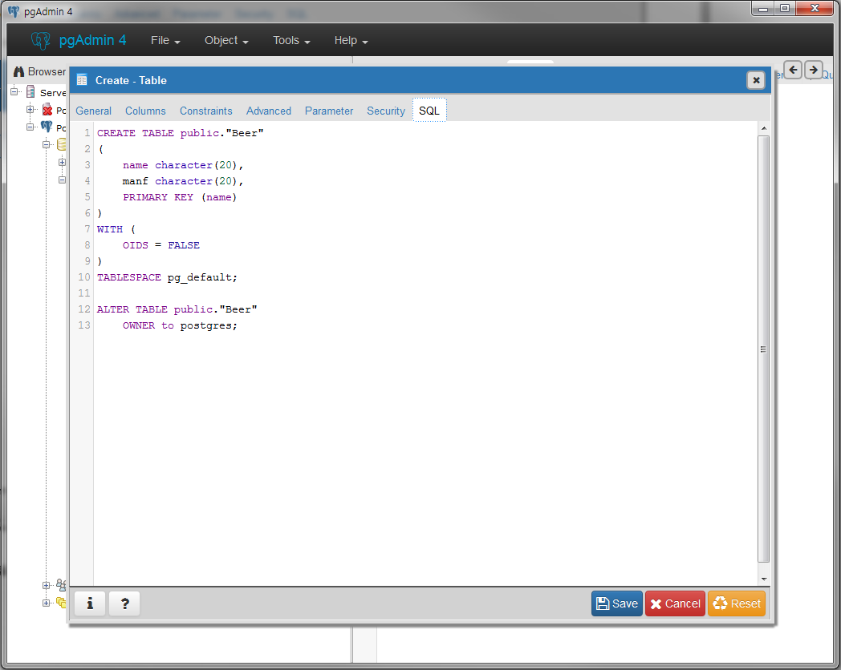
Create Table (1), (2) - complete
Add Columns
※PostgreSQL don’t support char type
instead, offer character type
Set Table Name
Then, SQL is auto-generated
Beer table is created

Slide 12
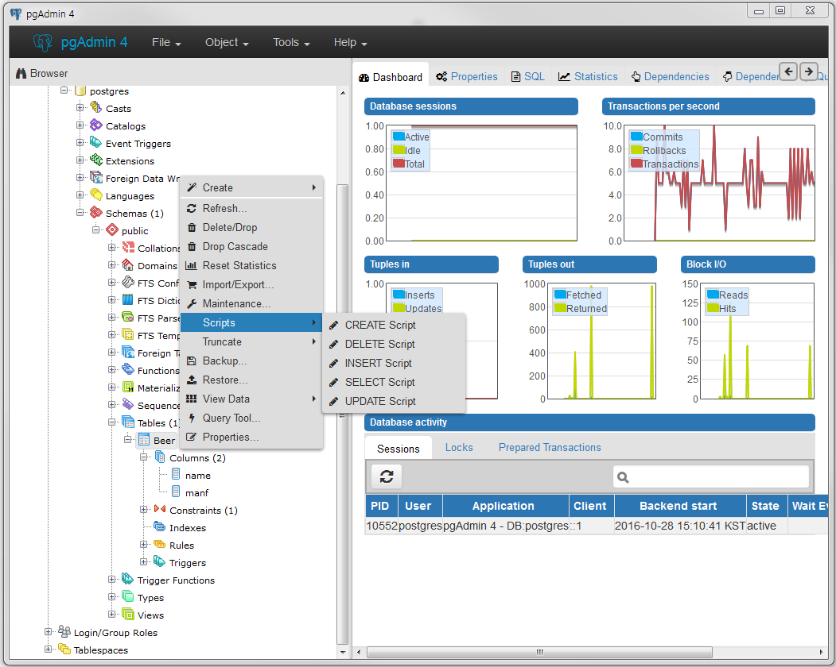
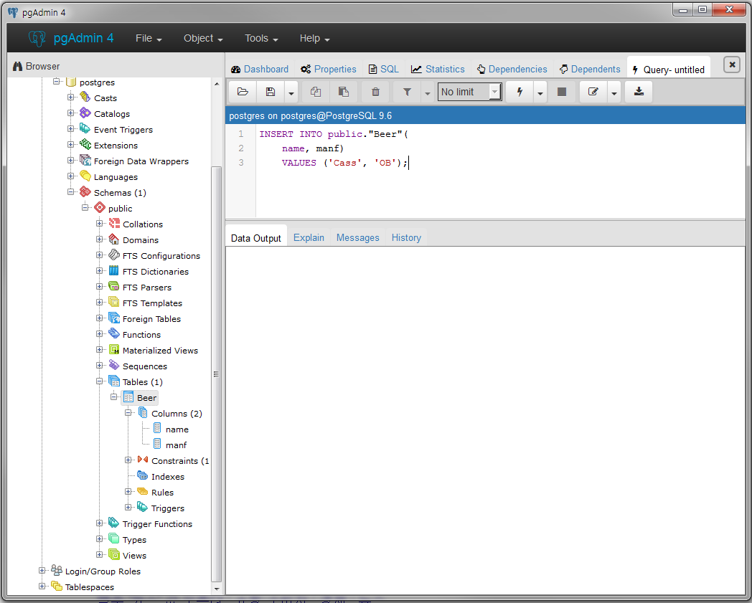
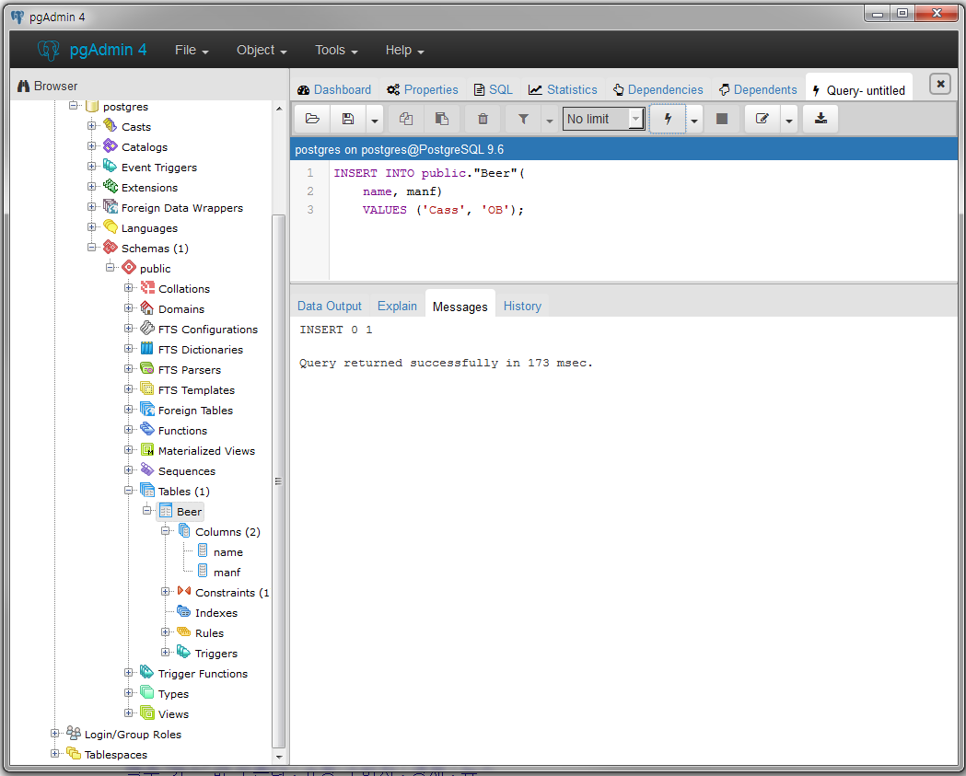
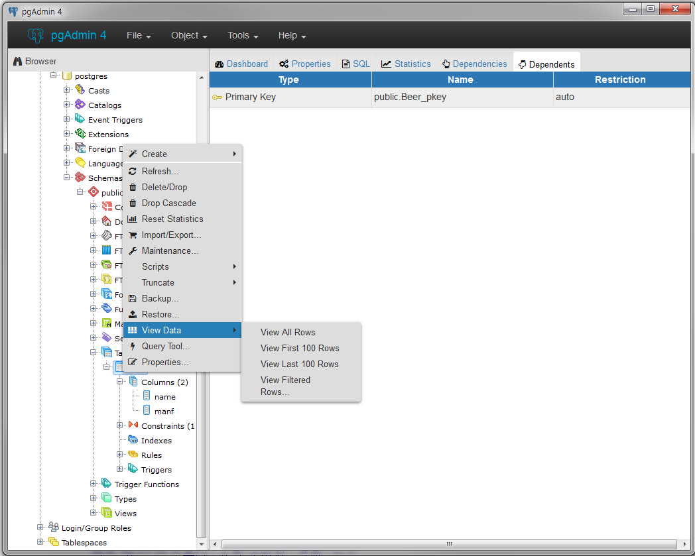
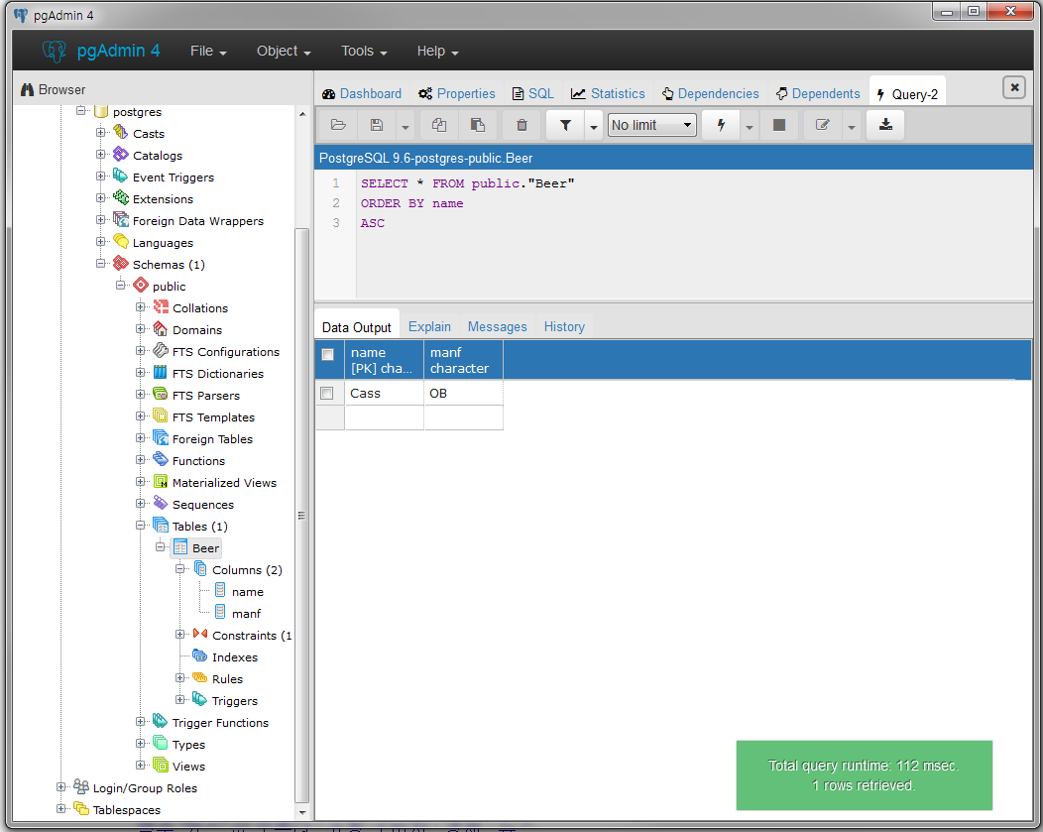
Insert the record and check the results
INSERT INTO Beers (name, manf)
VALUES ('Cass', 'OB');
Check insertion result
Select table and right click
→ View Data → View all Rows
Write Insert query and execute
Execution results
Select table(Beer) and right click
→ Scripts → INSERT Script

