Slide 1
PostgreSQL tutorial
2019, Fall
Pusan National University

Slide 2
What is PostgreSQL?
https://www.postgresql.org
The world’s most advanced open source database
Object-relational database (ORDBMS)
Cross-platform
Latest Version : 12 in Oct. 2019

Slide 3
Download PostgreSQL
Go to this URL
http://www.enterprisedb.com/products-services-training/pgdownload#windows
Select v 9.6.11 and choose OS

Slide 4
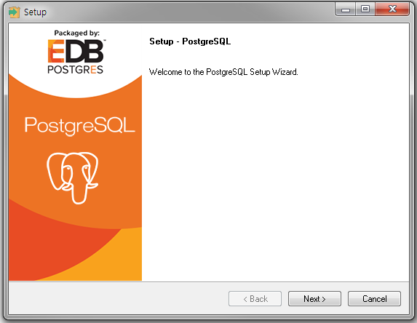
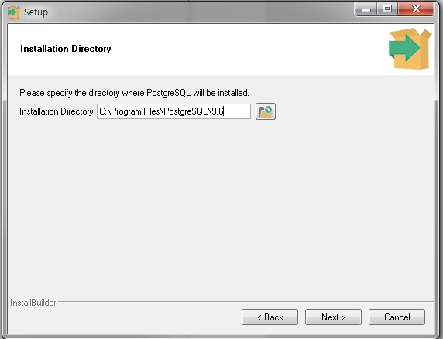
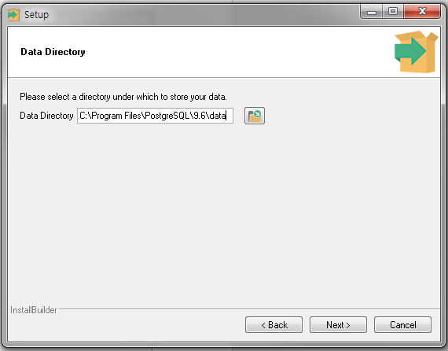
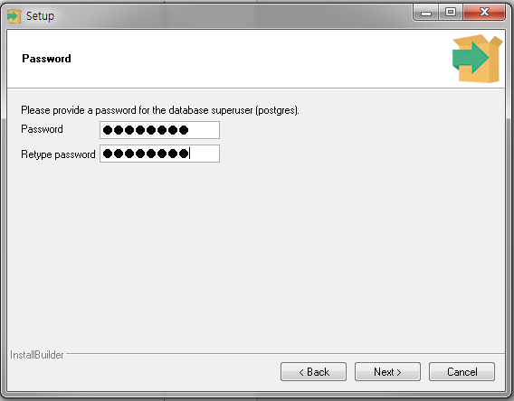
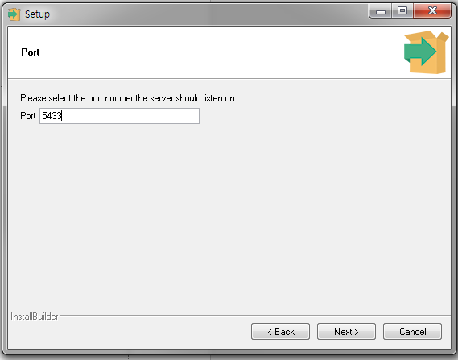
Install PostgreSQL
Lunch downloaded file(postgresql-9.6.1-xxx.exe)
Next..next..next..and set your password! And next

Slide 5
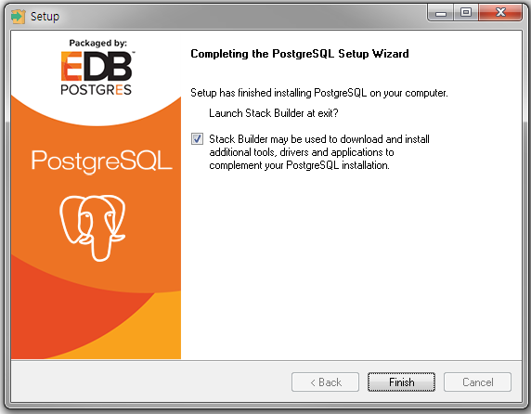
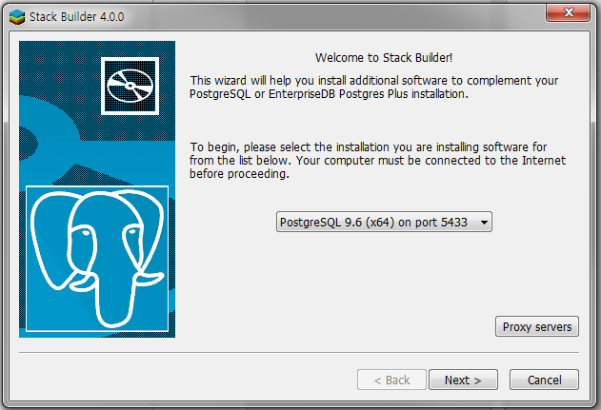
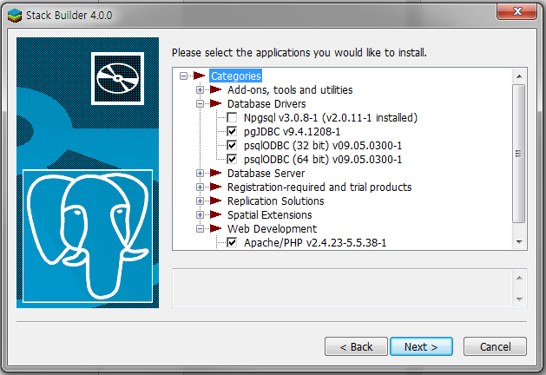
Stack Builder?
When the installation ends, you can choose this option
You can use the JDBC installation on Stack Builder
Other options? If you want, do it

Slide 6
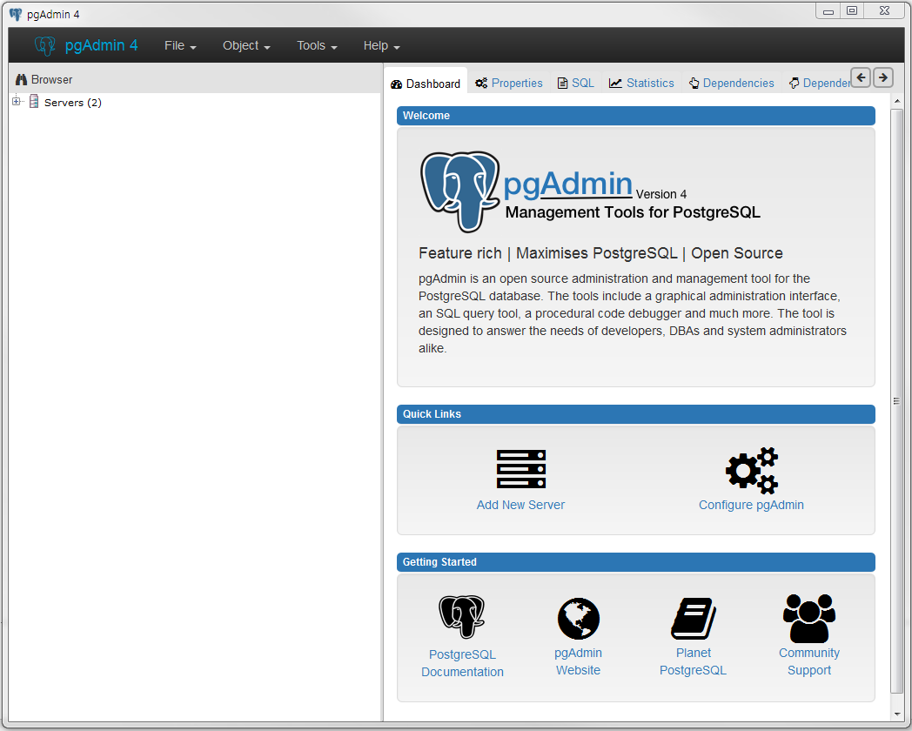
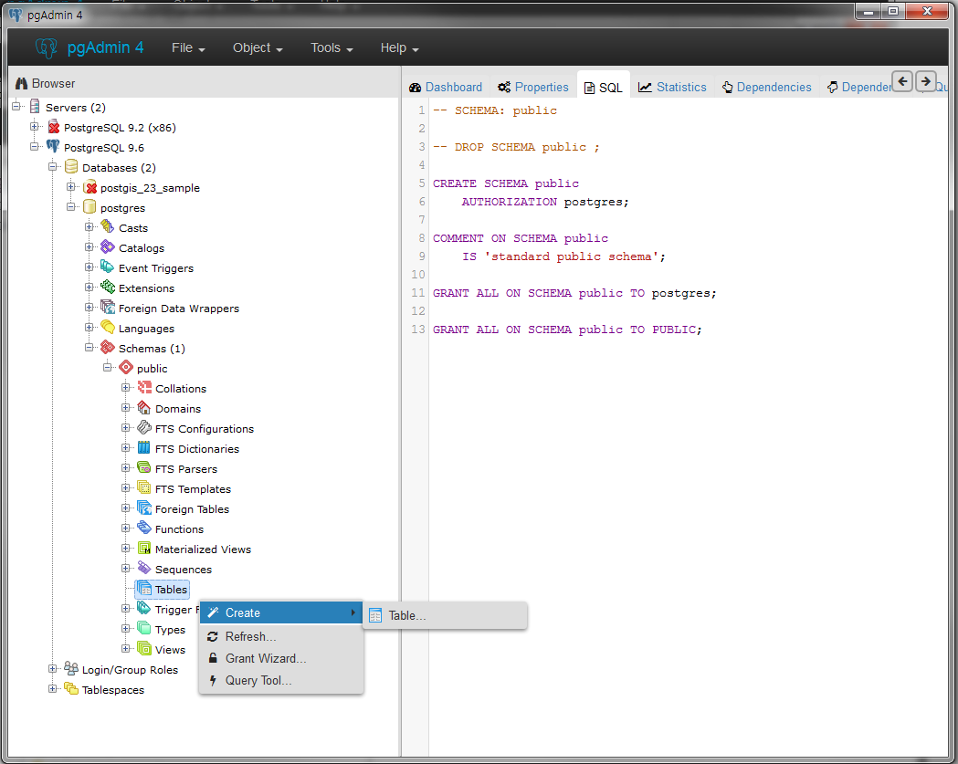
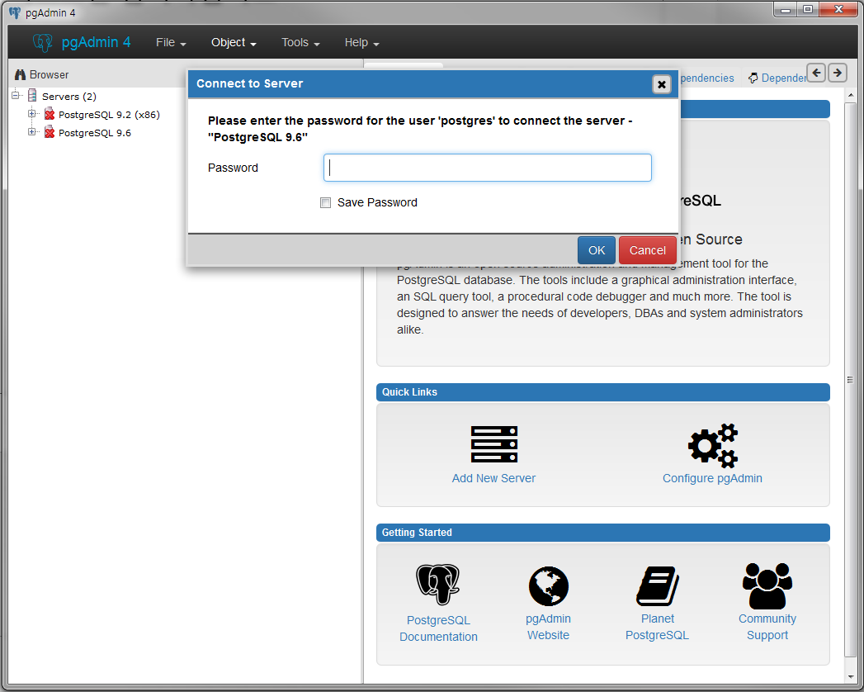
Launch pgAdmin 4
Databases → postgres
Schemas → public
tables → Create → Table
Select PostgrSQL 9.6
And enter your passwords
This is main screen

Slide 7
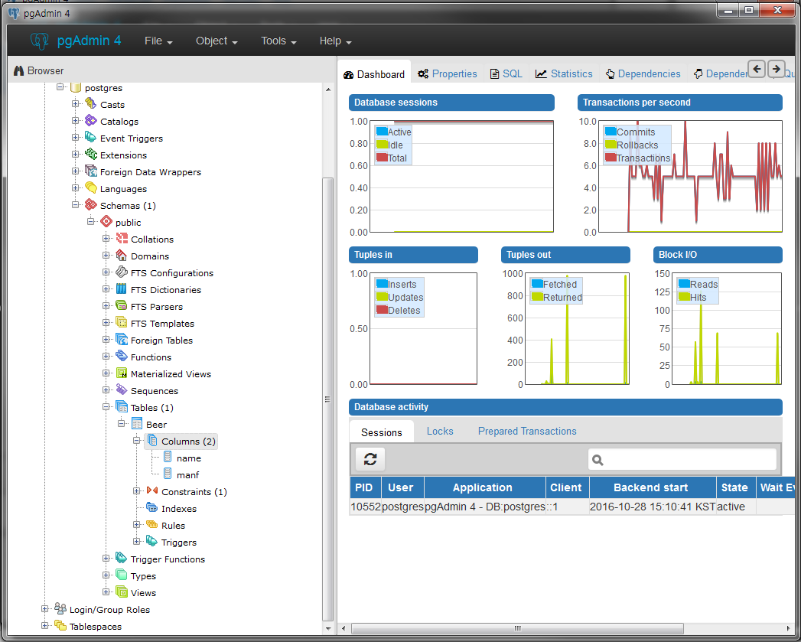
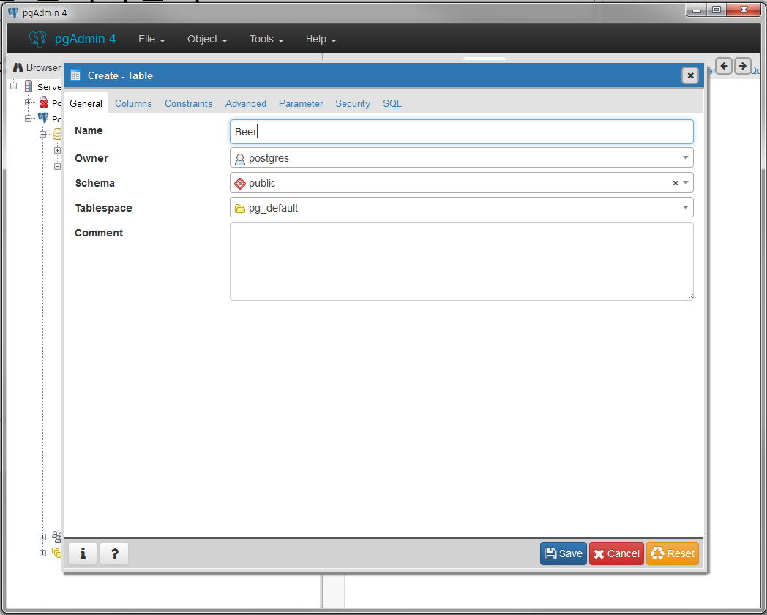
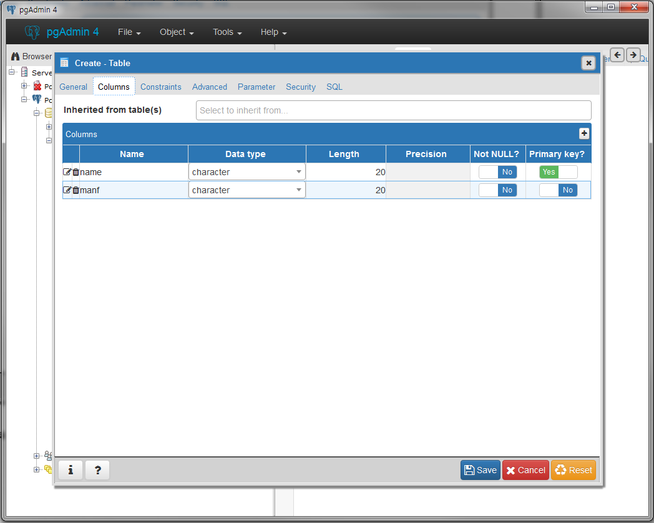
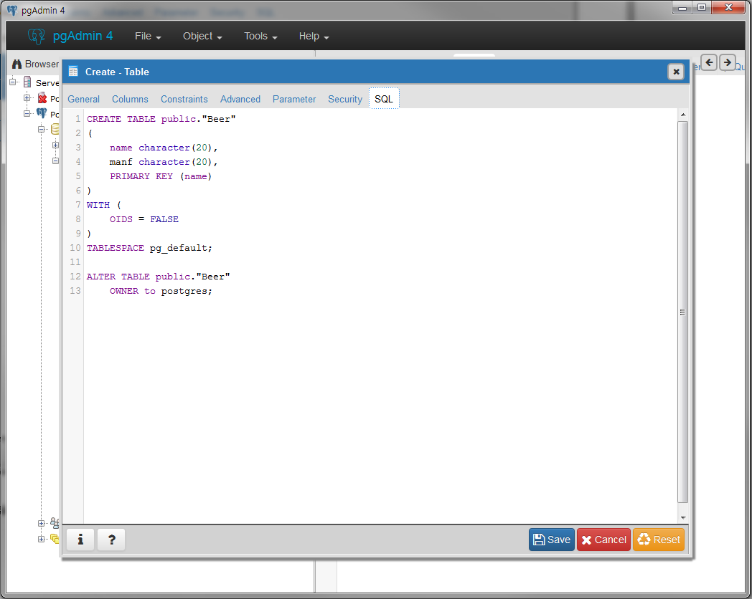
Create Table
CREATE TABLE Beers (
name CHAR(20),
manf CHAR(20),
PRIMARY KEY (name)
);
Add Columns
※PostgreSQL don’t support char type
instead, offer character type
Set Table Name
Then, SQL is auto-generated
Beer table is created

Slide 8
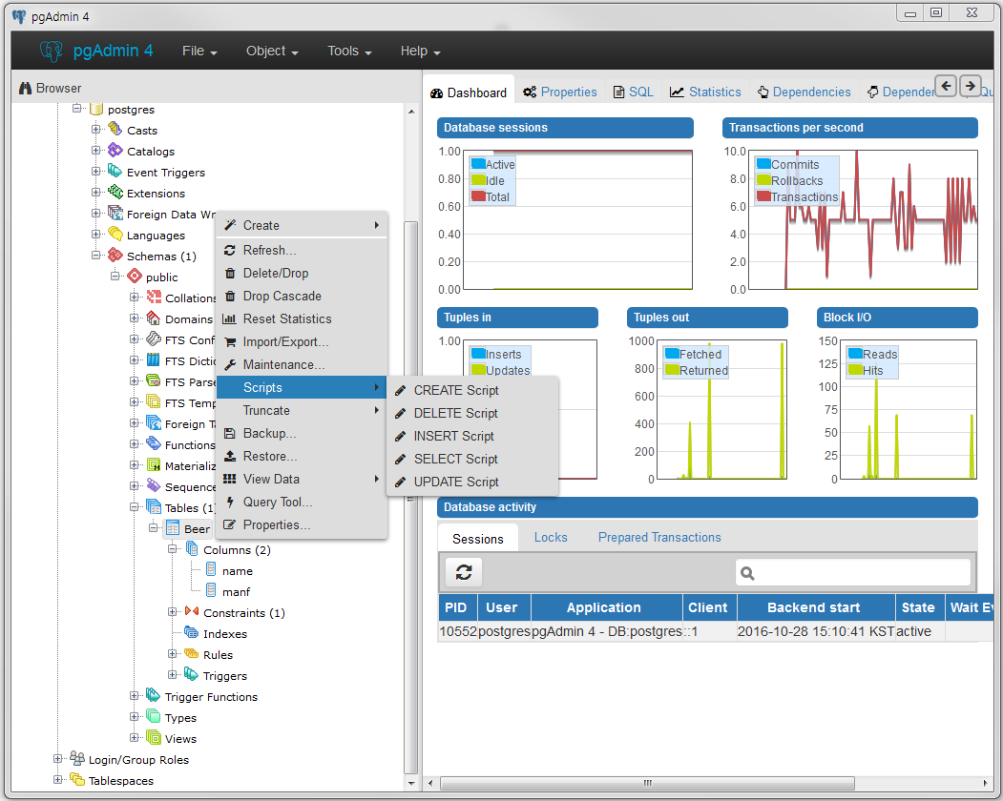
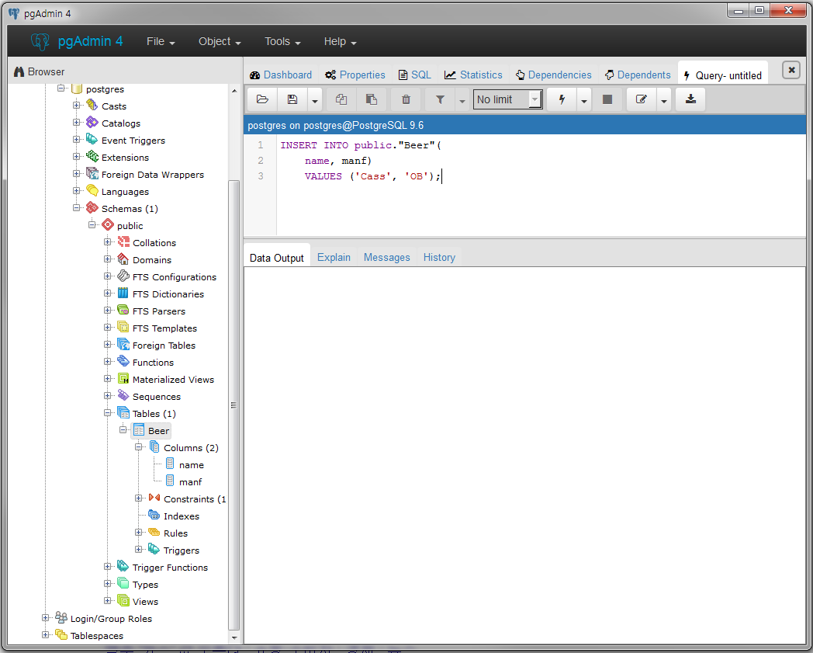
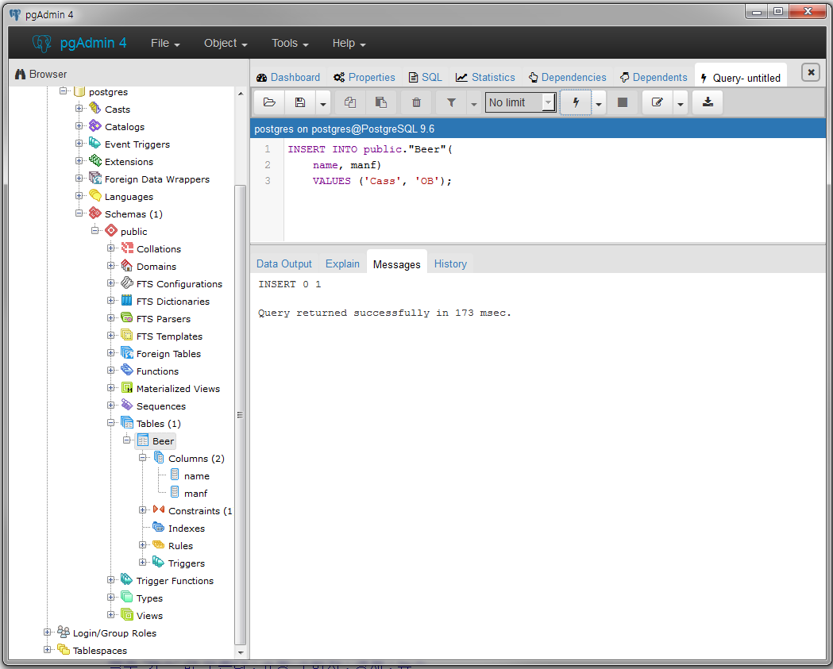
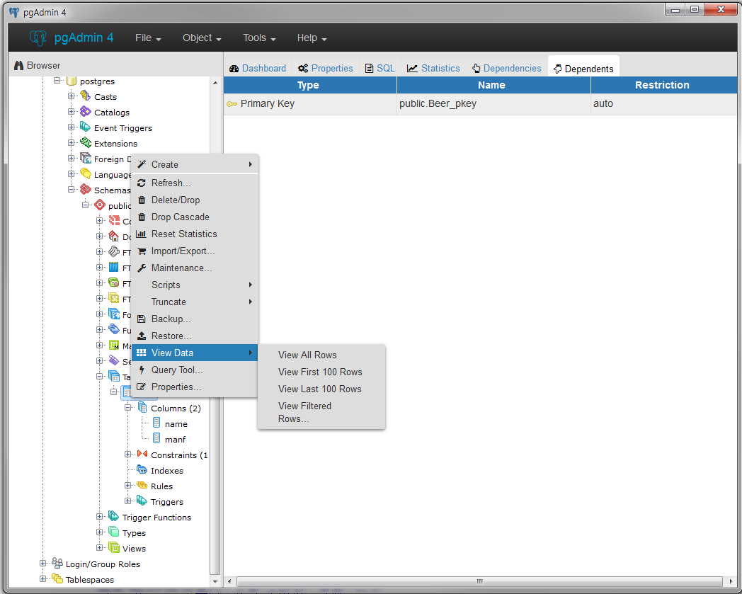
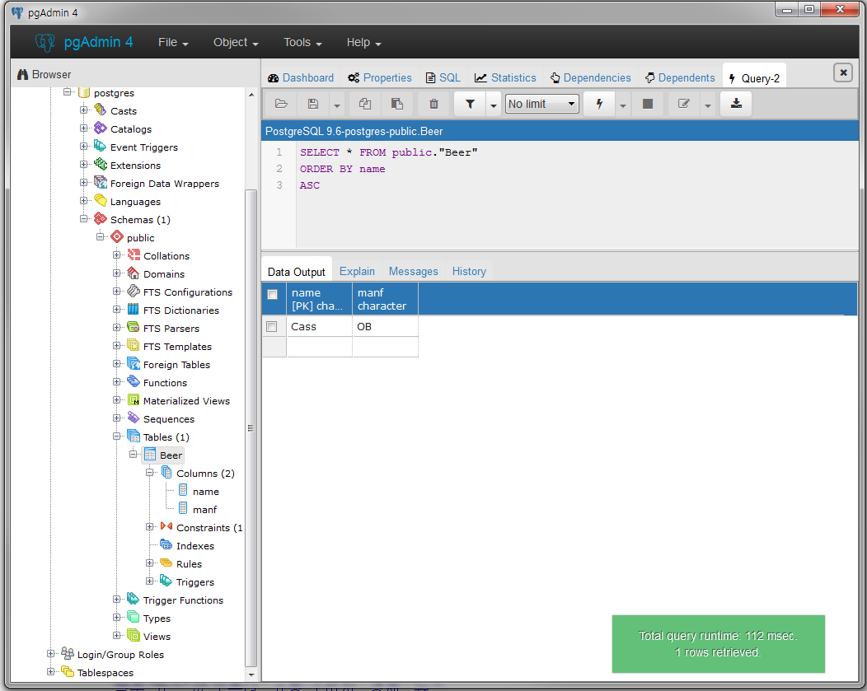
Insert the record and check the results
INSERT INTO Beers (name, manf)
VALUES (‘Cass’, ‘OB’);
Check insertion result
Select table and right click
→ View Data → View all Rows
Write Insert query and execute
Execution results
Select table(Beer) and right click
→ Scripts → INSERT Script

